Slide 1
NBA Champions and Runners-Up
Jack Kennedy, Becca Hittner,
Dustin Casey

Slide 2
Overview
Project Goals and Objectives
Data
Predicting Game Outcomes
Predicting Points Scored
Predicting Series Champions
Insights/Analysis
Recap

Slide 3
Project Goals and Objectives
Use NBA statistics to predict:
Game Outcomes
Points Scored
NBA Champions
Use both offensive (FGP, TPP, FT, etc.) and defensive (TOV, AST, STL, etc.) stats
Use logistic regression and stepwise selection to find the best variables
Hypotheses:
Relationship between statistics and wins, points scored, and championships (especially offensive stats)

Slide 4
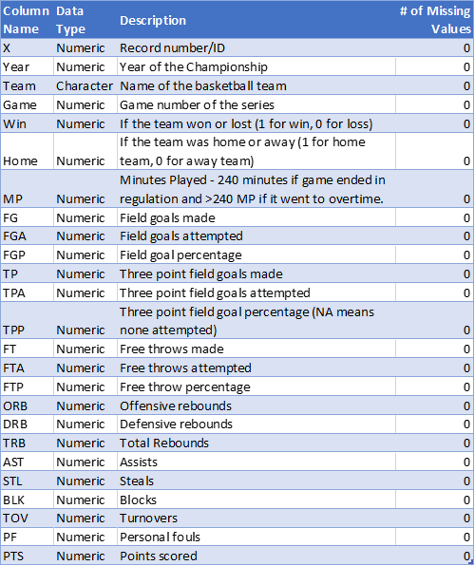
NBA Championship Series Data
Two Datasets – Champion and Runnerups data
216 records (rows) for each set (432 combined)
25 variables (columns)
Each record represents each game’s stats for the NBA Championship
Records from 1980 to 2017

Slide 5
Predicting Game Outcomes – Overview
Goal was to predict the probability a team had of winning a game based on their stats.
Logistic Regression models to achieve this
Probability threshold of 0.5 to make predictions
Training and Testing sets used to build model and test accuracy

Slide 6
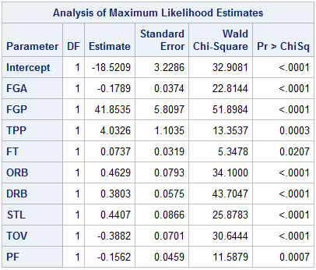
Predicting Game Outcomes – Model I
Used all variables to build model
Significant Variables:
Field Goal Percentage (FGP)
Defensive Rebounds (DRB)
Turnovers (TOV)
Personal Fouls (PF)
Free Throws Made (FT)
Offensive Rebounds (ORB)
Three Point Percentage (TPP)
Steals (STL)
Field Goals Attempted (FGA)
Model Accuracy – 86.79%
Test Set – 106 records
Notes:
The model has a Chi-Square value of 10.85, 7 degrees of freedom, and a p-value 0.1453. The Area Under the Curve for the model is 0.9425 or 94.25%.

Slide 7
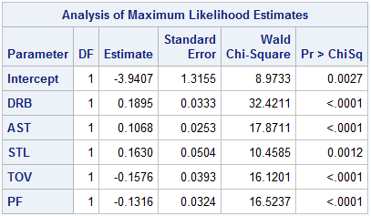
Predicting Game Outcomes – Model II
Excluded shooting stats (FG, TP, FT, etc.)
Significant Variables:
Defensive Rebounds (DRB)
Personal Fouls (PF)
Assists (AST)
Turnovers (TOV)
Steals (STL)
Model Accuracy – 71.7%
Test Set – 106 records
Notes:
The model has a Chi-Square value of 1.0215, 2 degrees of freedom, and a p-value 0.6. The Area Under the Curve for the model is 0.8160 or 81.6%.

Slide 8
Predicting Points Scored – Overview
Goal was to predict the average points scored in a series by a team based on their average series stats.
Multiple Regression models to achieve this
Training and Testing sets used to build model
Used residuals to test accuracy

Slide 9
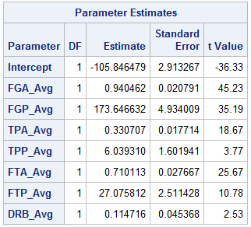
Predicting Points Scored – Model I
Excluded shooting stats FG, TP, and FT
If these variables are included in the model, the model will be 100% accurate as Points are directly derived from these three statistics.
Significant Variables:
Free Throw Attempts (FTA_Avg)
Field Goal Attempts (FGA_Avg)
Field Goal Percentage (FGP_Avg)
Three Point Attempts (TPA_Avg)
Free Throw Percentage (FTP_Avg)
Three Point Percentage (TPP_Avg)
Defensive Rebounds (DRB_Avg)
Model Fit Adjusted R² – 0.9922
Average Residual – 0.1745
Notes:
The model has a R-Squared value of 0.9932 or 99.32% and an Adjusted R-Squared value of 0.9922 or 99.22%. The average residual value of the model is 0.1745.

Slide 10
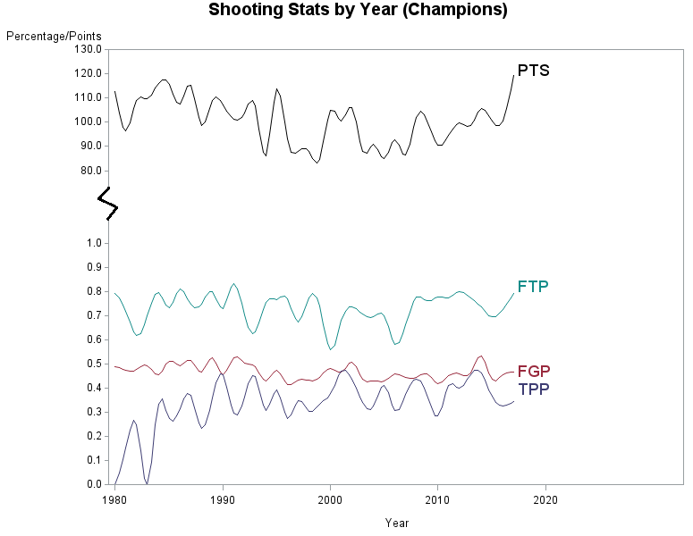
Predicting Points Scored – Model I
Notes:
The model has a Chi-Square value of 1.0215, 2 degrees of freedom, and a p-value 0.6. The Area Under the Curve for the model is 0.8160 or 81.6%.

Slide 11
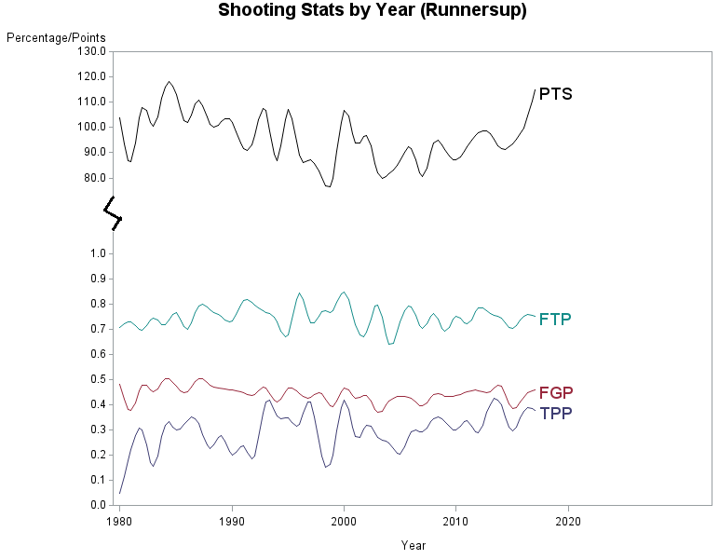
Predicting Points Scored – Model I
Notes:
The model has a Chi-Square value of 1.0215, 2 degrees of freedom, and a p-value 0.6. The Area Under the Curve for the model is 0.8160 or 81.6%.

Slide 12
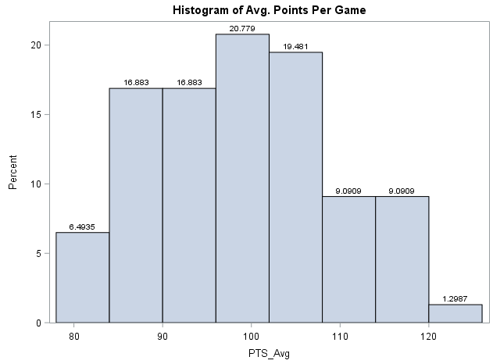
Predicting Points Scored – Model II
Excluded all shooting stats
Significant Variables:
Assists (AST_Avg)
Defensive Rebounds (DRB_Avg)
Model Fit Adjusted R² – 0.6049
Average Residual – 0.5814
Notes:
The model has a R-Squared value of 0.9932 or 99.32% and an Adjusted R-Squared value of 0.9922 or 99.22%. The average residual value of the model is 0.1745.

Slide 13
Predicting Series Champions – Overview
Goal was to predict the probability a team had of winning the championship based on their stats.
Logistic Regression models to achieve this
Probability threshold of 0.36 to make predictions
Training and Testing sets used to build model and test accuracy

Slide 14
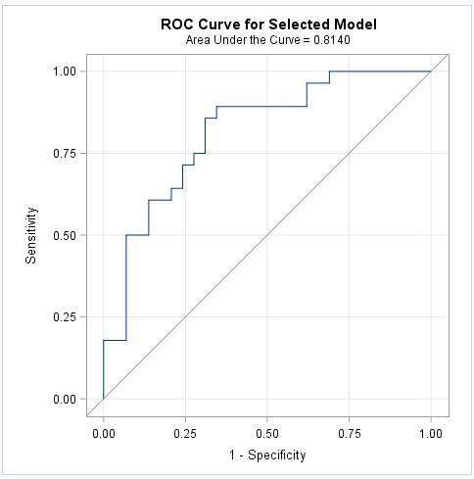
Predicting Series Champions – Results
Used all variables to build model
Significant Variables:
Field Goal Percentage (FGP_Avg)
Field Goals Attempted (FGA_Avg)
Personal Fouls (PF_Avg)
Chi-Square Value – 33.539
P-Value – 0.0014
Model Accuracy – 65.0%
Test Set – 20 records

Slide 15
Insights and Analysis
Shooting Stats to predict points:
99.22% model fit and 0.1745 average residual value
Non-Shooting Stats to predict points:
60.49% model fit and 0.5814 average residual value
Shooting Stats to predict game outcomes: 86.79% accurate
Significant Variables: (FGP), (DRB), (TOV), (PF), (FT), (ORB), (TPP), (STL), (FGA)
Non-Shooting Stats to predict game outcomes: 71.7% accurate
Significant Variables: (DRB), (PF), (AST), (TOV), (STL)
Predicting Champion: 65.0% accurate
Significant Variables: (FGP_Avg), (FTA_Avg), (PF_Avg).

Slide 16
Recap
Project Goals and Objectives
Data
Predicting Game Outcomes
Predicting Points Scored
Predicting Series Champions
Insights/Analysis

Slide 17
Questions?

